Slide 1
Simple Example on EM algorithm
The example has been borrowed from a tutorial on EM Clustering by Chuong B Do & Serafim Batzoglou
Let us assume that we have 2 biased coins (A and B) with different levels of biasness
Let us also assume that one of the coins is chosen at random and tossed 10 times and the outcomes are recorded
If it is known which coin was tossed in each turn, finding out the parameters would be very easy
However, things get complicated if this information is not available
In this situation, an iterative EM algorithm would work well

Slide 2
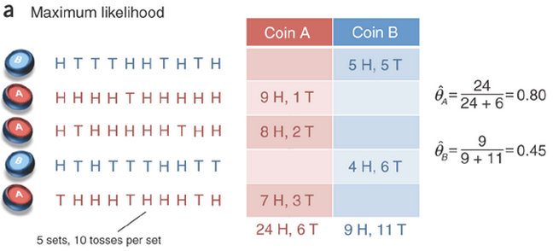
Simple Example on EM algorithm
If all the relevant information are available, parameter estimation turns out to be maximum likelihood estimates as shown below
How to get the estimates of θ if it is not known which coin was tossed? Simple Maximum Likelihood Estimation is not possible in this situation

Slide 3
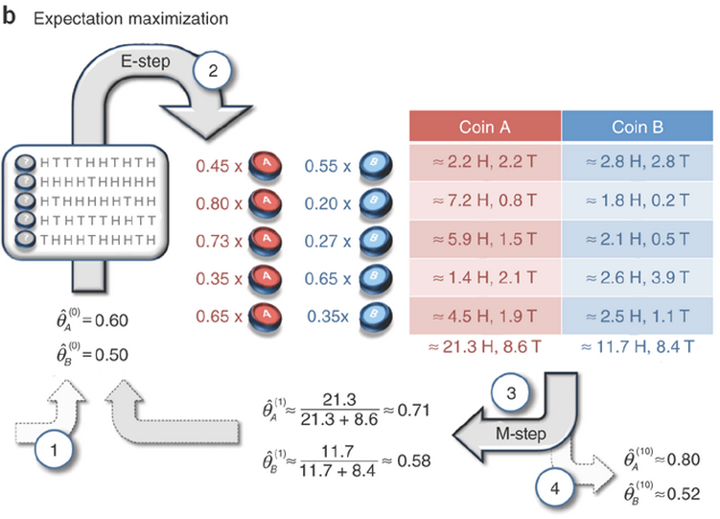
Simple Example on EM algorithm
EM process to get the estimates of θ.
Step 1: Initial guess of θ value
Step 2: Estimate probability of association with initial guess of θ
Step 3: Find new value of θ with the help of parameters estimated in step 2 and supply the same for next iteration
Step 4: Stop when the value of θ converges
How to get these values in step 2

Slide 4
Sample Calculations
In the first trial, there are 5 heads and 5 tails
Assuming binomial distribution, with parameter θ_{A} = 0.6 and θ_{B} = 0.5, we get following probabilities of getting heads (success)
Probability association with coin A is
Probability association with coin B is 1-0.45= 0.55

